Slide 1
ADS-B EXPERIMENT
A Wireless Communication Project
-PES2UG22EC063
K P RAGHAVENDRA
-PES2UG22EC137
Sophia D Antoinette
-PES2UG22EC017
AKSHAY C C

Slide 2
Introduction
What is ADS-B?
Automatic Dependent Surveillance–Broadcast (ADS-B) is a surveillance technology in which aircraft broadcast their position, altitude, velocity, and other data.
Widely used in air traffic control and aircraft tracking.
Objective of the Experiment:
To receive and decode ADS-B signals from aircraft using a Software-Defined Radio (SDR) setup and visualize them using a virtual radar.

Slide 3
Tools and Equipment Required
Hardware
RTL-SDR Dongle: A low-cost USB-based Software-Defined Radio receiver.
Antenna: 1090 MHz antenna for receiving ADS-B signals.
Computer : For running decoding software and visualizing data.
Software
Dump1090: An open-source ADS-B decoder.
Virtual Radar Server: Software for visualizing decoded ADS-B data on a map.
RTL-SDR Drivers: Necessary drivers for the RTL-SDR dongle.

Slide 4
Procedure (Step 1 - Setup)
Install RTL-SDR Drivers
Install the required drivers to make the RTL-SDR dongle work with your system.
Set Up Antenna and Dongle
Connect the 1090 MHz antenna to the RTL-SDR dongle.
Plug the RTL-SDR dongle into the USB port of the computer.

Slide 5
Procedure (Step 2 - Software Installation)
Download and Install Dump1090:
Install the Dump1090 software for decoding ADS-B signals.
Install Virtual Radar Server
Set up the Virtual Radar Server to visualize aircraft positions.

Slide 6
Procedure (Step 3 - Running the Experiment)
Start Dump1090
Run Dump1090 to begin receiving and decoding ADS-B signals from aircraft.
Configure Virtual Radar Server*
Use the decoded data from Dump1090 to display aircraft positions on a map.
Real-Time Aircraft Tracking*
Observe the positions, altitude, speed, and other parameters of nearby aircraft.

Slide 7
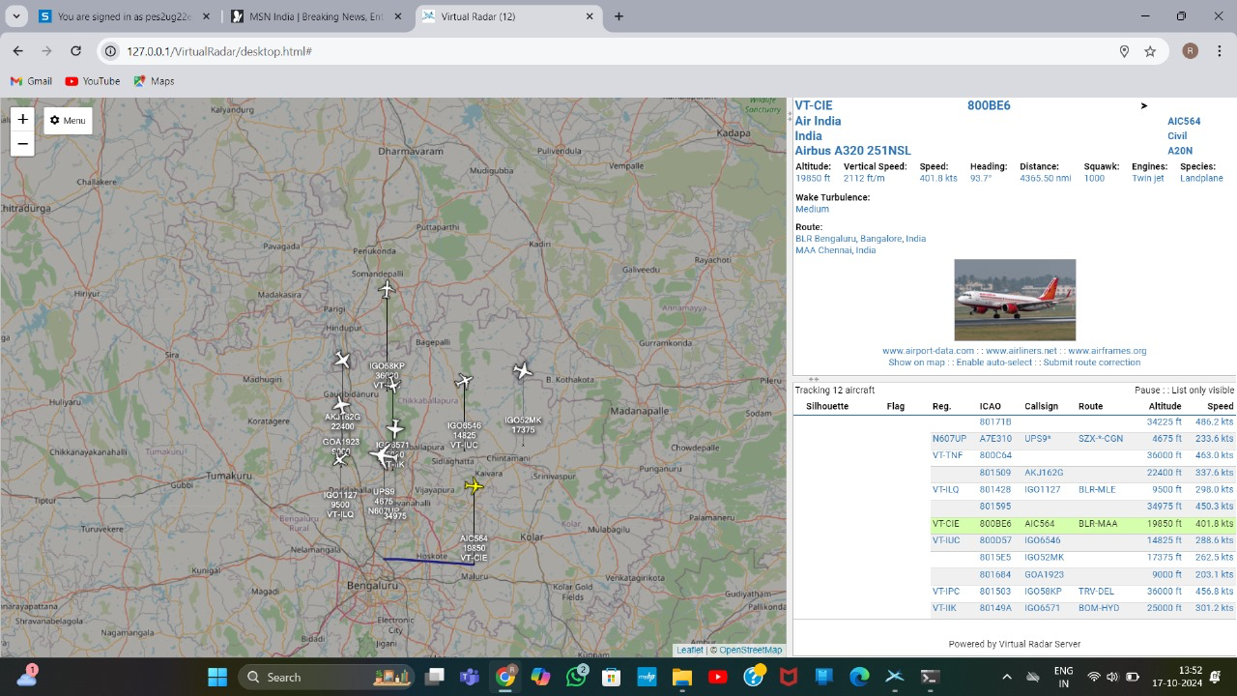
Results and Observations

Slide 8
Conclusion
Successfully received and decoded ADS-B signals using RTL-SDR and Dump1090.
Demonstrated real-time aircraft tracking and visualization using Virtual Radar Server.

